Slide 1
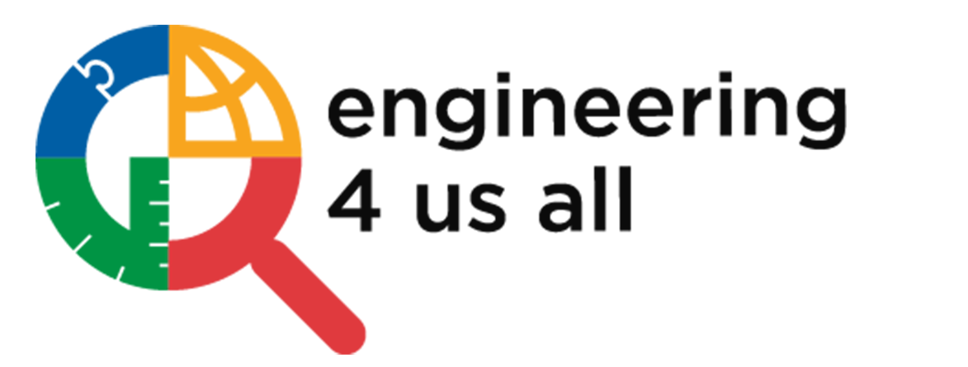
Shaping Future Engineers:
Strategic Consulting for E4USA's Expansion and Impact
Notes:
Gautam

Slide 2

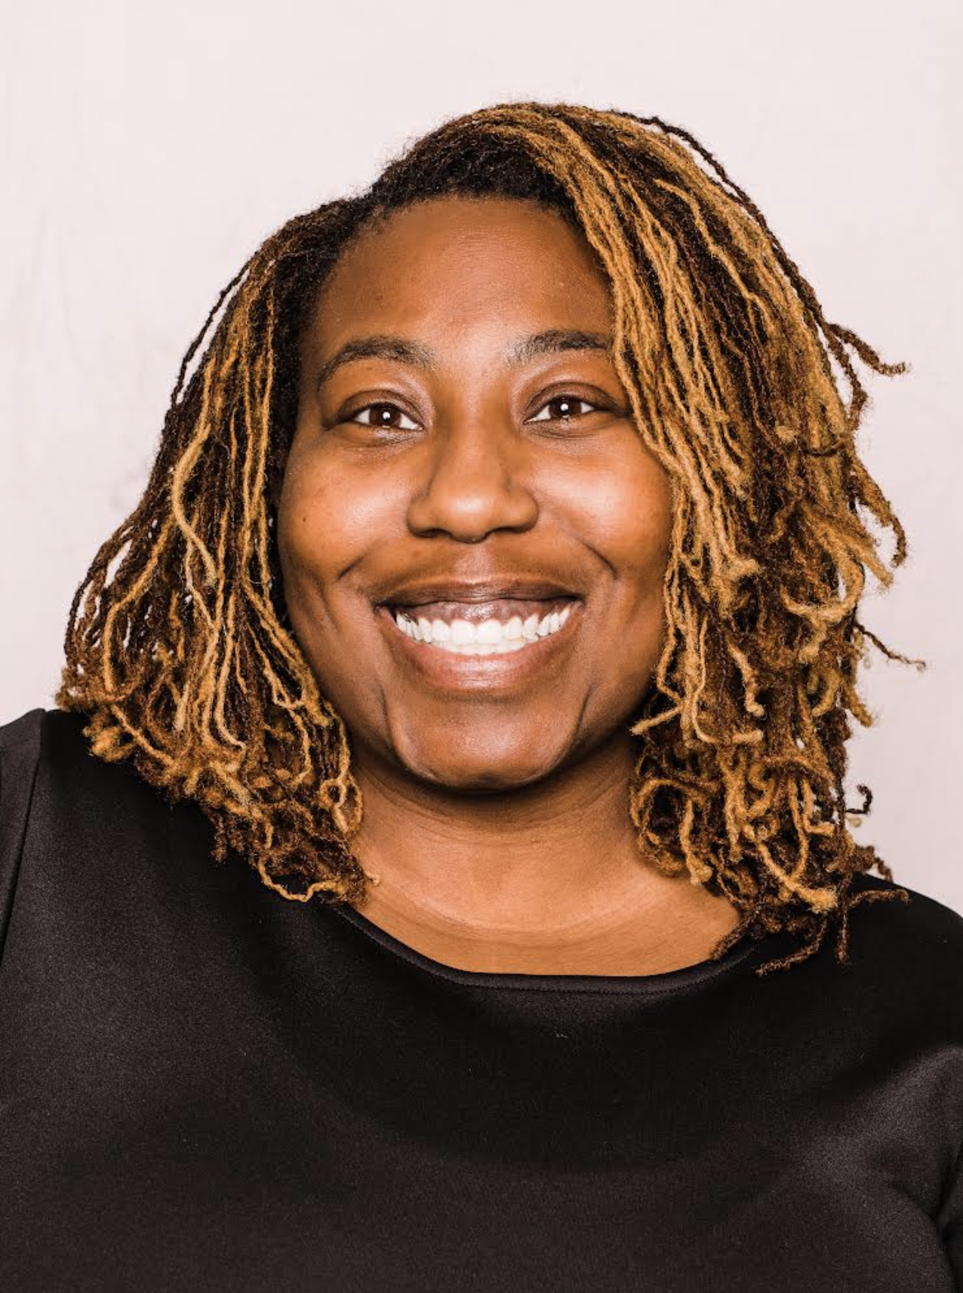



Meet Our Team!
Gautam Bhatia
Team Lead
Glodian Mimiko
Project Manager
Yuyan Wang
Engagement Manager
Isha Joshi
Analyst
Rutuja Samant
Analyst
Notes:
Gautam

Slide 3


Evolution and Importance of Engineering
Historical Evolution: From ancient architectural feats to modern interdisciplinary domains including computer science, biotechnology, and materials science.
Vital Role: Crucial in every industry—healthcare, transportation, AI, cybersecurity—driving innovation and economic growth.
Notes:
Gautam

Slide 4
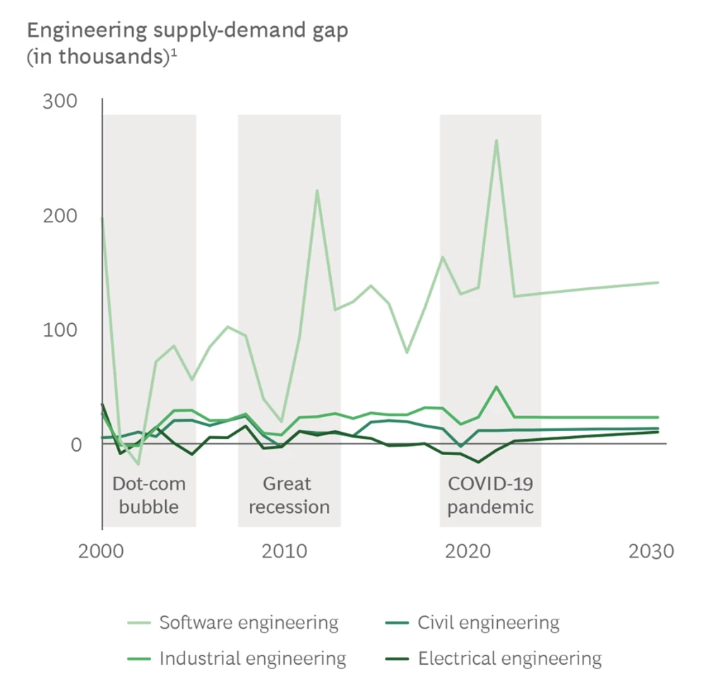
Engineering in Addressing
Global Challenges
Innovative Solutions: Engineers tackle complex problems such as climate change, healthcare, and sustainability.
Industry Demand: High demand for engineers due to rapid technological advancements, with interdisciplinary collaboration enhancing the problem-solving process.
The shortfall for filling roles with next generation-skills, especially in software engineering, is 186,000.
Notes:
Gautam Sources: US Beaurau of Labor Statistics, National Science Foundation, American Society of Engineering Education, US Citizen and Immigration Services, BCG Analysis

Slide 5
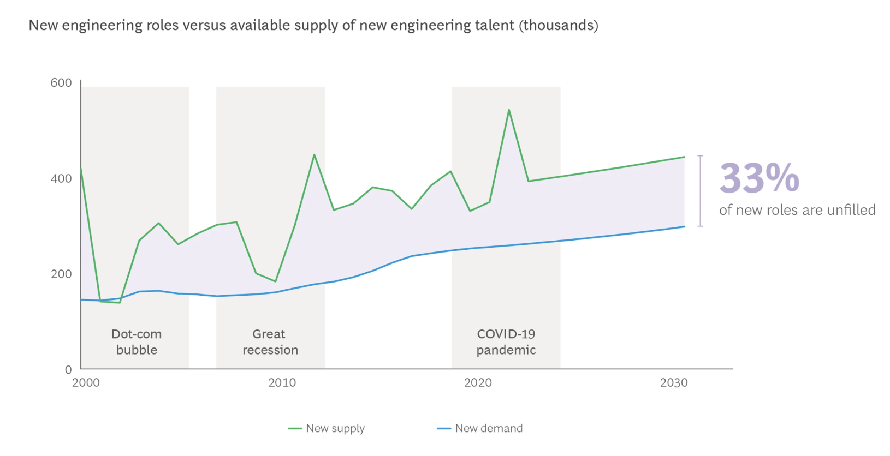
Need and Scope for Engineering Education
Wages and Job Growth:
The median annual wage for engineers was $91,010 in May 2020.
Job growth for engineers is projected at 5% from 2020 to 2030, according to the Bureau of Labor Statistics.
Engineering Jobs in the US:
In 2019, there were approximately 2.4 million engineering jobs in the United States.
The majority of these jobs were in civil, mechanical, and industrial engineering, according to the National Science Foundation.
Enrollment and Employment Trends:
Enrollment in undergraduate engineering programs increased by 2.3% from 2019 to 2020, based on a survey by the American Society for Engineering Education.
The U.S. Bureau of Labor Statistics projects a 4% growth in employment for engineers from 2019 to 2029, with over 60,000 new jobs expected to be added.
One in three Engineering roles goes Unfilled each year, hindering the US Economy
Notes:
Gautam Sources: US Beaurau of Labor Statistics, National Science Foundation, American Society of Engineering Education, US Citizen and Immigration Services, BCG Analysis

Slide 6









Educational institutions (schools, universities)
Industry partners (engineering firms, tech companies)
Nonprofit organizations (STEM-focused organizations)
Sponsors and donors
Partner engagement and collaboration
Marketing and outreach efforts
Comprehensive STEM education
Accessible learning platform
Industry-aligned curriculum
Opportunities for sponsor visibility and community impact
Students
Teachers/educators
Educational institutions
Sponsors and donors
KEY PARTNERS
KEY ACTIVITIES
VALUE PROPOSITIONS
CUSTOMER
SEGMENTS
Personalized support for educators and students
Engagement through social media and online communities
Regular communication through newsletters and updates
CUSTOMER RELATIONSHIP
Marketing/Sales Personel
Funding and grants
Social media
Educational forums and communities
Email newsletters
Educational conferences?events
KEY
RESOURCES
CHANNELS
Personnel costs (salaries, benefits)
Technology costs (platform development, maintenance)
Marketing and outreach expenses
Administrative expenses
Sponsorships and donations
Grants and funding
Licensing fees for premium content or features
COST STRUCTURE
REVENUE STREAM
BUSINESS MODEL CANVAS
Notes:
Glo

Slide 7




PEST ANALYSIS
Regulation changes in local, state and federal government (education sector)
Government support for STEM education
Grants & Funding
Education Policy changes related to curriculum standards, graduation requirements
Economic problems can lead to lower funding
Job Market - stronger market/demand for engineers will lead to more participants
Increased cost of implementing the program
Cultural attitudes towards engineering
as a career choice.
Perception about engineering
Diversity and Inclusion: underrepresented populations
Community engagement : Building strong connections with locals
Disparities between accessing technology for digital curriculum
Alignment with latest technology used in education
Digital literacy for teachers and students
Online learning presents opportunities and challenges
Notes:
Isha: Political:
Regulation changes at local, state, and federal levels can impact the education sector, including curriculum standards and graduation requirements.
Government support for STEM education through policies and initiatives.
Grants and funding availability from government sources to support educational programs.
eDUCATION POLICY CHANGES
Economic:
Economic problems may lead to lower funding for education, impacting resources available for STEM programs.
Job market conditions influence demand for STEM-related professions, affecting participation in STEM education initiatives.
Increased cost of implementing STEM education programs due to factors such as technology integration.
Social:
Cultural attitudes towards engineering as a career choice may influence participation in STEM education and career paths.
Perception about engineering and STEM fields within society can affect interest and engagement in STEM education.
Diversity and inclusion efforts to address underrepresented populations in STEM education and careers.
Community engagement initiatives to build strong connections with local communities and stakeholders.
Technological:
Disparities in accessing technology can impact the implementation of digital curriculum and online learning.
Alignment with the latest technology used in education to ensure relevance and effectiveness of STEM programs.
Digital literacy for both teachers and students to effectively utilize technology in education.
Opportunities and challenges presented by online learning platforms in delivering STEM education.

Slide 8
PORTER'S FIVE FORCES ANALYSIS
THREAT OF NEW ENTRY
POWER OF BUYERS
THREAT OF SUBSTITUTES
POWER OF SUPPLIERS
Low to Moderate:
Barriers to entry such as establishing credibility, building a network of schools, and developing effective educational content act as deterrents to potential new entrants.
Moderate to high: Schools and donors can negotiate for better pricing and demand higher quality content due to multiple options available.
Moderate:
Traditional educational institutions, other online learning platforms, and self-paced learning resources could potentially serve as substitutes
Low:
Abundance of tech suppliers reduces individual bargaining power, allowing E4USA to negotiate favorable terms and prices.
…
…
…
…
COMPETITIVE RIVALRY
…
High:
E4USA operates in a crowded market, requiring differentiation and continuous innovation
to maintain market share.
Notes:
Rutuja

Slide 9
Opportunity Statement
E4USA is poised to revolutionize engineering education through strategic financial and marketing initiatives. We see key opportunities in optimizing our financial and marketing strategies:
Financial Strategy Optimization:
Evaluate current funding sources and explore new revenue streams to ensure stability and foster growth.
Diversify funding sources for resilience against market fluctuations and to support our expansion plans.
Marketing Strategy Optimization:
Identify target audiences and tailor our marketing efforts to reach diverse populations effectively.
Develop a comprehensive marketing plan that includes targeted campaigns and engaging content to enhance visibility and impact.
Collaborate with strategic partners to amplify our reach and ensure the sustainability of our initiatives.
By addressing sector-specific challenges and leveraging targeted campaigns, strategic partnerships, and engaging content, E4USA can effectively communicate its mission, secure funding, and drive the evolution of engineering education nationwide."
Notes:
Lily

Slide 10
Project Objectives and Benefits : Finance
Project Objective 1: Financial strategy optimization
Evaluate current financial sources and identify strengths, weaknesses and gaps in funding structure.
Explore new revenue streams and seek partnerships aligned with mission of E4USA. (corporations, philanthropic organizations and government agencies)
Benefits:
Sustainability: Ensures long-term financial stability.
Flexibility: Provides resilience against economic uncertainties.
Growth: Facilitates expansion of new programs and initiatives.
Innovation: Development of new projects and partnerships.
Impact: The organization can fulfill its mission and create positive change.
Notes:
Isha

Slide 11
Project Objectives and Benefits : Marketing
Project Objective 2: Marketing strategy optimization
Identify demographic needs and understand the ideal communication channels.
Develop a comprehensive marketing plan using different channels online and offline.
Tailor marketing efforts to reach diverse populations in different regions and socioeconomic backgrounds.
Collaborate with educational institutions, community organizations, and industry partners to extend reach and access new audiences.
Benefits:
Increased Awareness and Engagement
Expanded Reach
Improved Recruitment and Retention
Enhanced Partnerships
Long-Term Sustainability
Notes:
Isha

Slide 12
Deliverable Questions - Funding
Research for a funding plan for that includes various factors and strategies to secure financial support for the E4USA’s mission and programs.
Research will answer the following for E4USA:
Funding Sources:
What are the potential sources of funding available?
Should funding come from individual donors, corporate sponsors, grants, government contracts, or other sources?
What are the restrictions or limitations associated with each funding source?
Fundraising Strategies:
What fundraising strategies will be employed to generate funds for the E4USA?
Should E4USA focus on individual giving, major gifts, corporate partnerships, events, grants, or other fundraising methods?
How should fundraising strategies be tailored to appeal to different donor segments?
Notes:
Glo

Slide 13
Deliverable Questions - Funding
Research for a funding plan for that includes various factors and strategies to secure financial support for the E4USA’s mission and programs.
Research will answer the following for E4USA:
Communication and Outreach:
How should E4USA communicate its funding needs and impact to donors and supporters?
What channels and platforms should be used to engage with donors, including email, social media, website, events, and direct mail?
What messaging and storytelling techniques should be employed to effectively convey the organization's mission and impact?
Relationship Building:
How will E4USA cultivate and maintain relationships with donors and supporters?
What stewardship and recognition strategies should be implemented to show appreciation for donor contributions?
How should E4USA engage donors in the organization's mission beyond financial support?
Notes:
Glo

Slide 14


Leveraging Corporate Partnerships to Enhance STEM Education Funding and Resources
Google:
Google for Education: Utilize Google's comprehensive suite of educational tools and platforms to enhance classroom learning and teacher effectiveness. Google provides both funding and technology that can be integrated into STEM programs to foster innovative learning environments.
CS First: Engage with Google’s free computer science curriculum to introduce students to coding at an early age, designed to motivate and inspire students by using video-based activities with real-world themes.
Microsoft:
TEALS (Technology Education and Literacy in Schools): Partner with Microsoft to bring industry professionals into classrooms as volunteers to help teach computer science, providing both expertise and mentorship to students and teachers.
Microsoft Imagine Academy: Access a full curriculum and resources for developing tech skills in students, including materials for teaching and learning about cloud technologies, artificial intelligence, and data science.
Notes:
Gautam

Slide 15


Leveraging Corporate Partnerships to Enhance STEM Education Funding and Resources
Amazon:
Amazon Future Engineer: This program supports education in computer science and robotics, providing both funding and curriculum resources, particularly in underrepresented and underserved communities. It offers students scholarships and internships to foster their career paths in technology.
AWS Educate: Integrate Amazon's cloud computing curriculum into STEM programs, offering educators and students resources to build and validate cloud technology skills, including credits and professional training.
IBM:
IBM SkillsBuild: This initiative provides online learning paths in subjects like cybersecurity, AI, and cloud applications. It includes hands-on projects and personalized coaching, aiming to prepare students for "new collar" jobs in technology fields.
P-TECH (Pathways in Technology Early College High School): Establish a connection with P-TECH schools to offer students a pathway from high school to college and into the workforce, focusing on STEM skills with mentorships and internships that connect education to real-world job opportunities.
Notes:
Gautam

Slide 16


Leveraging NGO/NPO Partnerships to Elevate Future Changemakers for Social Impact
Ashoka:
"Ashoka Young Changemakers" program identifies and supports young people who are creating positive change in their communities. By partnering with e4USA, Ashoka can help inspire and support high school students to use their engineering skills to drive social impact and innovation.
Ashoka's network of social entrepreneurs includes many who are using engineering and technology to solve social and environmental challenges. Collaborating with e4USA can help Ashoka create a pipeline of diverse young engineers who can contribute to their network and mission.
"Impact at Work" initiative helps professionals integrate social and environmental impact into their careers. By partnering with e4USA, Net Impact can inspire high school students to pursue engineering careers that align with their values and make a positive difference in the world.
"Impact Investing" program educates and empowers individuals to invest in companies and funds that generate social and environmental impact alongside financial returns. Many impact investing opportunities involve engineering and technology solutions. By supporting e4USA, Net Impact can help create a pipeline of diverse engineers who can drive innovation in the impact investing space.
Notes:
Lily

Slide 17


Leveraging Foundation Partnerships to Empower Future Changemakers
"My Brother's Keeper Alliance" aims to address persistent opportunity gaps facing boys and young men of color. By partnering with e4USA, the Obama Foundation can help increase access to high-quality engineering education for underrepresented minority students, providing them with the skills and confidence to succeed in STEM careers.
"Obama Leaders" program brings together emerging leaders from around the world to collaborate on solutions to complex challenges. Engineering skills are critical for developing innovative solutions to global problems.
"Postsecondary Success" initiative aims to increase the number of students who complete a postsecondary degree or credential, with a focus on low-income and minority students. By partnering with e4USA, the Gates Foundation can help prepare underserved high school students for success in postsecondary engineering programs.
"Global Education" program works to ensure that students in low- and middle-income countries can acquire the skills they need to thrive in the 21st-century economy. Engineering is a critical skill set for driving economic development and solving global challenges. By supporting e4USA, the Gates Foundation can help develop a model for high-quality, accessible engineering education that can be adapted and scaled in other countries.
Notes:
Lily

Slide 18
Deliverable Questions - Marketing
Marketing Plan and Tactics research that serves as a comprehensive guide that outlines the strategies, actions, and resources needed to effectively promote a E4USA to potential schools and donors.
Research will answer the following for E4USA:
Marketing Strategies:
What overall approach should E4USA take to reach your target audience?
Which marketing channels (digital, social media, traditional, etc.) should be utilized?
How should E4USA integrate online and offline marketing efforts for maximum impact?
Tactical Implementation:
What specific tactics should be used to execute your marketing strategies?
How should E4USA frame it story for developing compelling content to engage its targets?
Notes:
Glo

Slide 19
Deliverable Questions - Marketing
Marketing Plan and Tactics research that serves as a comprehensive guide that outlines the strategies, actions, and resources needed to effectively promote a E4USA to potential schools and donors.
Research will answer the following for E4USA:
Market Analysis:
What is the current state of the market?
Who are E4USA’s primary competitors, and what are their strengths and weaknesses?
What trends are influencing your industry?
Who are E4USA’s target school decision makers, and what are their needs and preferences?
Unique Selling Proposition (USP):
What sets your E4USA’s apart from competitors?
How should E4USA’s communicate its USP effectively to the target audience?
Notes:
Glo

Slide 20





MARKETING STRATEGY
MAIN ASPECTS TO ENSURE EFFECTIVENESS
DEFINE YOUR TARGET AUDIENCE
SET CLEAR
OBJECTIVES
DEVELOP A COMPELLING VALUE PROPOSITION
CHOOSE APPROPRIATE MARKETING CHANNELS
CREATE ENGAGING CONTENT
Ability to sustain operations long term
Partner with new schools
Comprehensive curriculum
Interactive modules
Virtual labs and simulations
Accessible
Personalized learning paths
Teacher support
Real-world project-based learning
Social media
Educational communities
Email campaigns
Educational conferences and trade shows
Partnering with educational influencers
Networking with engineering professionals and organizations
Infographics illustrating concepts
Short educational videos
Student testimonials & success stories
Customers: curriculum writers, principals, or headmasters
Sponsors: Marketing managers, Corporate Relations Engineering or Corporate Relations of large companies for STEM
Notes:
Glo

Slide 21
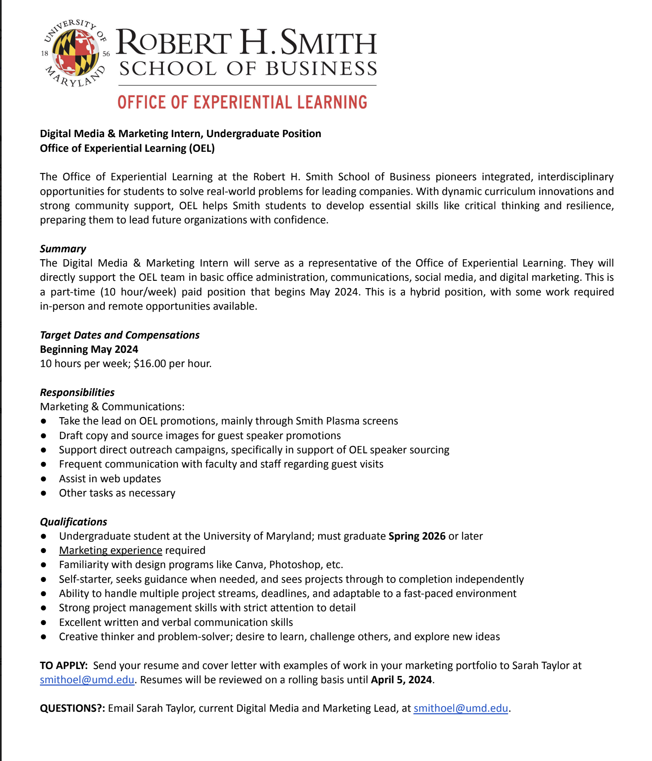
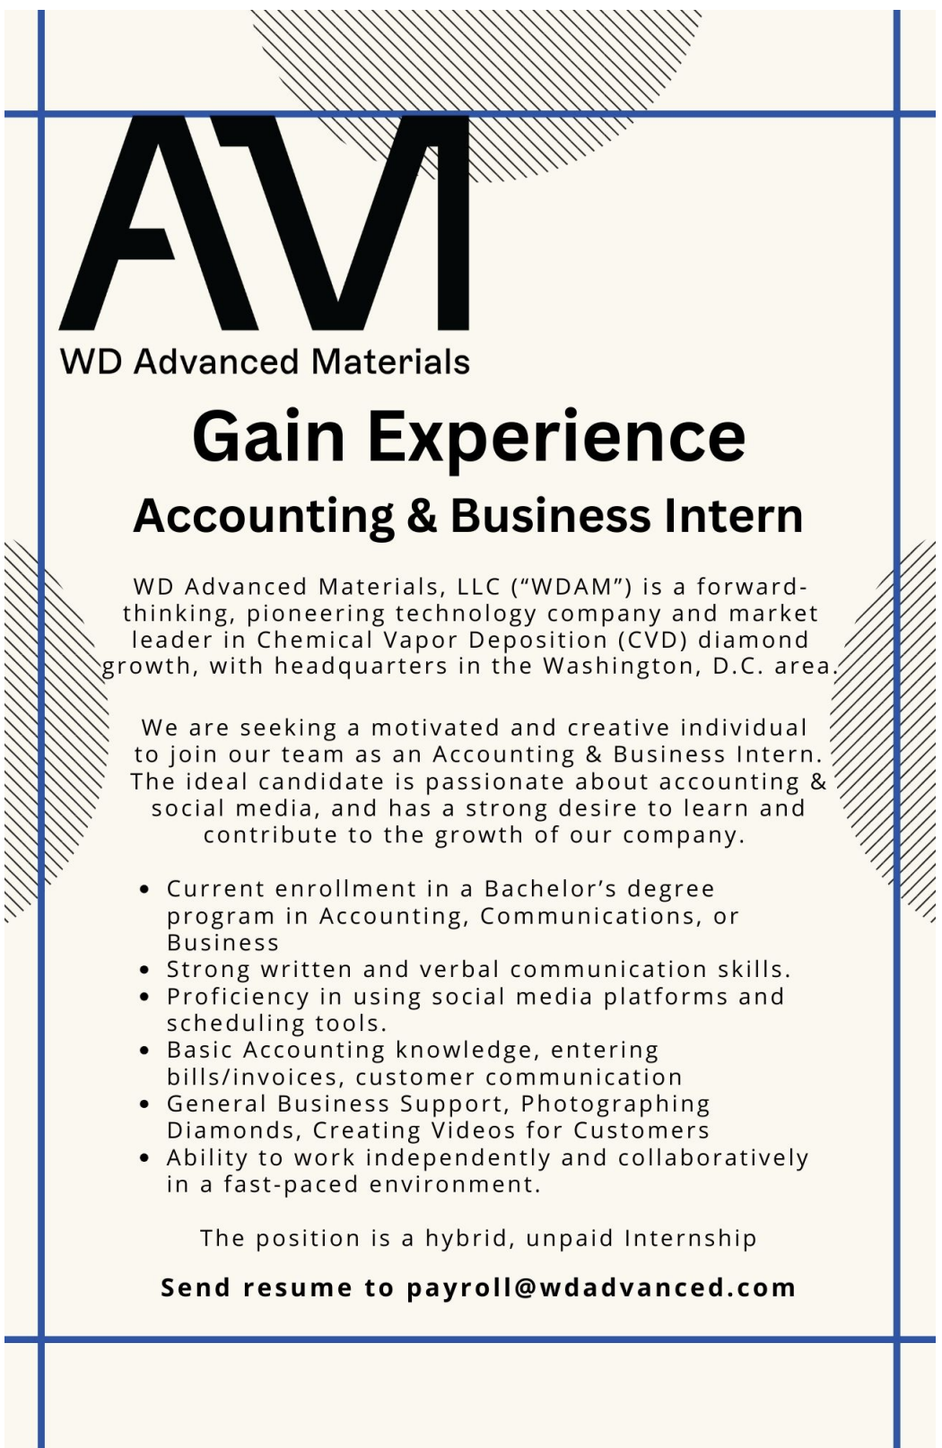
Hire Interns from UMD Marketing Department
One-pager requirements:
1. Company logo
2. Company history/background/HQ location ( 1-2 paragraphs)
3. Job title and responsibilities (one paragraph)
4. Skills you are looking for
5. Virtual, in-person, hybrid
6. Approximate compensation level
7. Contact information for sending resume and cover letter
Contact:
Mary B. Harms
Academic Director for Marketing Internships
mharms@umd.edu
Notes:
Gautam I would gladly promote your internships to marketing students. In fact, I just got off the phone with a marketing student studying in Madrid who is looking for an internship this summer. I mentioned your internship and she is interested.
I send out email blasts to all undergraduate marketing students 3 - 4 times a month.

Slide 22
Problems our
Strategy Faces
Solution / Vision
Employ direct mail campaigns, online crowdfunding, major donor cultivation, peer-to-peer fundraising, planned giving programs, and donor stewardship initiatives to stand out.
Seek funding from various avenues and offer sponsorship opportunities, cause-related marketing campaigns, employee engagement programs, and corporate giving initiatives.
Challenges raising fund for Edtech:
Edtech sector is highly competitive
Finding sustainable investors is difficult.
Industry specific challenges:
Developing and maintaining EdTech platforms can be technically complex.
Integrating Edtech solutions into existing educational infrastructure is challenging.
Develop intuitive solutions to simplify complexities for educators and learners.
Collaborate with educational institutions for seamless integration of Edtech solutions into existing infrastructure.
Notes:
Rutuja

Slide 23
Problems our
Strategy Faces
Solution / Vision
Launch targeted awareness campaigns to educate potential donors. Utilize storytelling, testimonials, and multimedia content to convey the significance of engineering education for all.
Mobilize resources through strategic partnerships with affinities for curriculum writers, principals, or headmasters(AMLE) or engineering affinities(IEEE)
E4USA specific challenges:
Educating donors about E4USA's mission and impact is challenging
Expanding nationwide requires substantial resources and strategic partnerships
Marketing Challenges:
Identifying and reaching the right audience of potential donors and partners can be challenging.
Capturing and retaining the attention in a crowded digital landscape poses a significant marketing challenge.
Detailed Proposal Packet for high schools for marketing along with current cold message strategy.
Deploy interactive and engaging content across digital channels like Instagram to capture and retain audience attention.
Notes:
Rutuja

Slide 24
Thank You!

